Slide 1
Notes:
1936 Burned the Cripta with all documentation from Gaudi.
Gaudi died in 1926.
Only 10% of the Cathedral was build by then.

Slide 2

HOW MANY YEARS?
?
Notes:
How much time do you think it took the team to get back on track and resume the construction?
Took them 6 years to continue the work.
This means that what we are looking at might not be what Gaudi firstly envision.
Photo by <a href="https://unsplash.com/@danielkcheung?utm_source=unsplash&utm_medium=referral&utm_content=creditCopyText">Daniel K Cheung</a> on <a href="https://unsplash.com/photos/ZqqlOZyGG7g?utm_source=unsplash&utm_medium=referral&utm_content=creditCopyText">Unsplash</a>

Slide 3
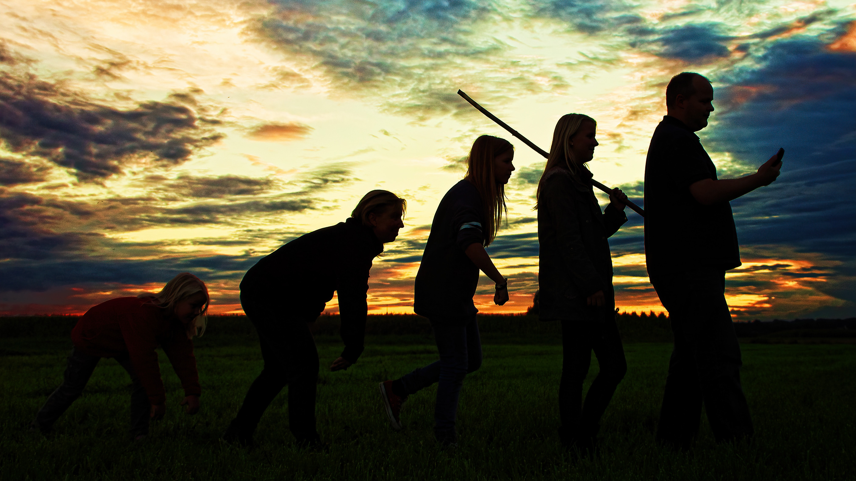
Evolutionary architecture
Notes:
We evolve based on iteration…

Slide 4

Experimentation
Notes:
Gaudi is using previous projects as references. Just like we do.
Cathedral of Mallorca.

